Slide 1
CHAPTER 1- ICT
revision

Slide 14
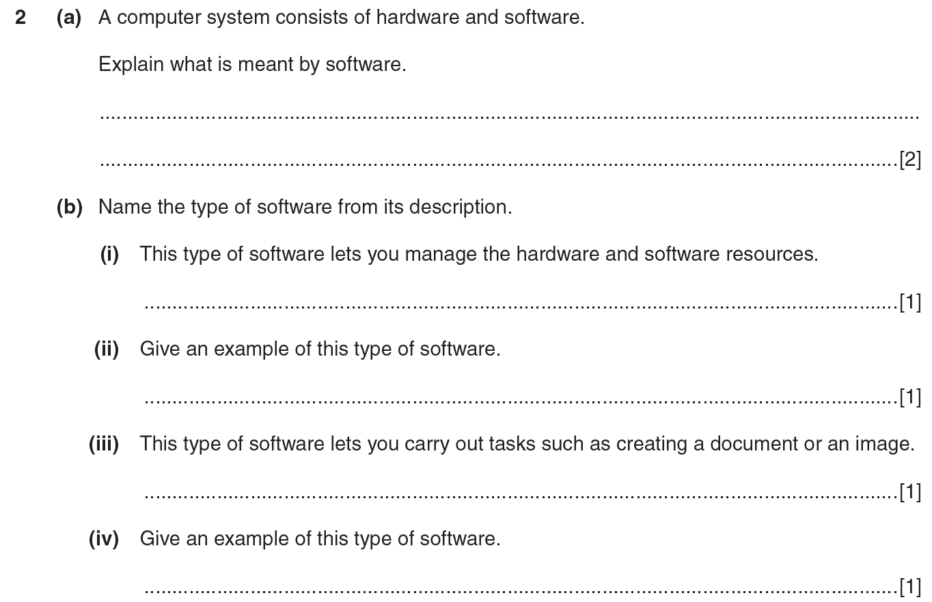

Slide 24
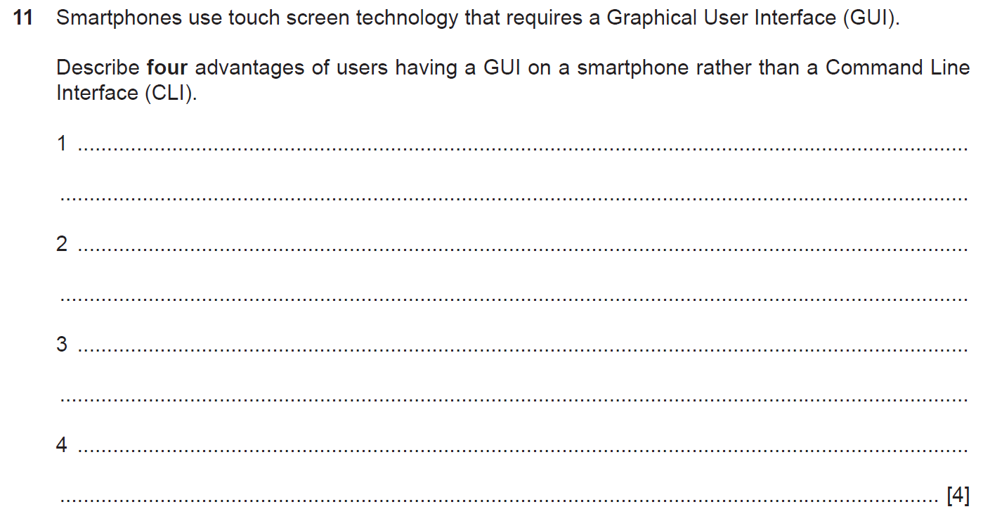

Slide 32
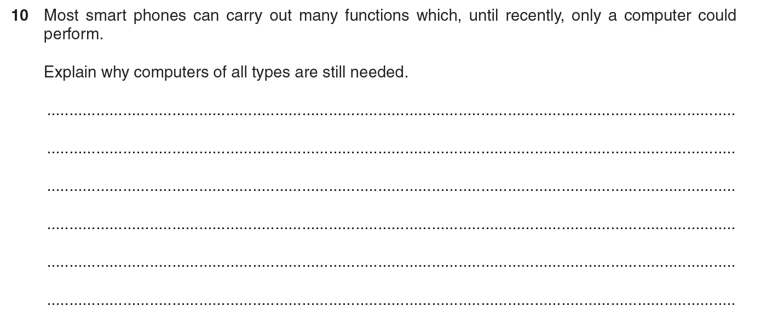

Slide 34
Open ICT papers at home and try answering questions related to chapter 1.
If you are in doubt on how to answer, please write down the question number and ask you teacher during class discussion

